Slide 1
Web engineering lecture 2

Slide 2
Web terminologies

Slide 3
URL
URL: Uniform Resource Locator
It stands for the address of a website.
Example:The URL of Albayan newspaper is
http://www.albayan.ae

Slide 4
Domain name and ip address
Each Web server has a unique IP address and a domain name.
For Example:
URL:http://www.google.com
Domain Name of the web server: google.com
IP Address of the web server:209:85:148:108

Slide 5
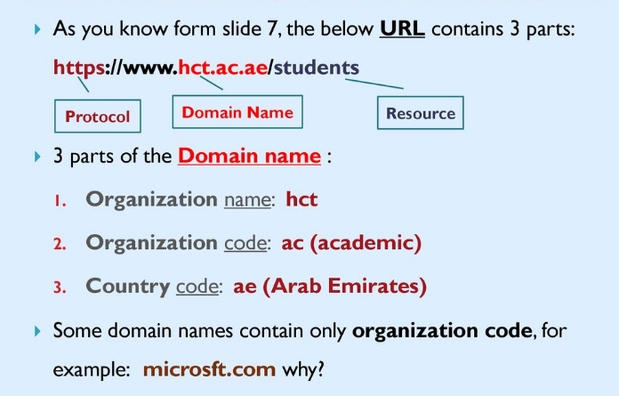
Parts of domain name

Slide 6
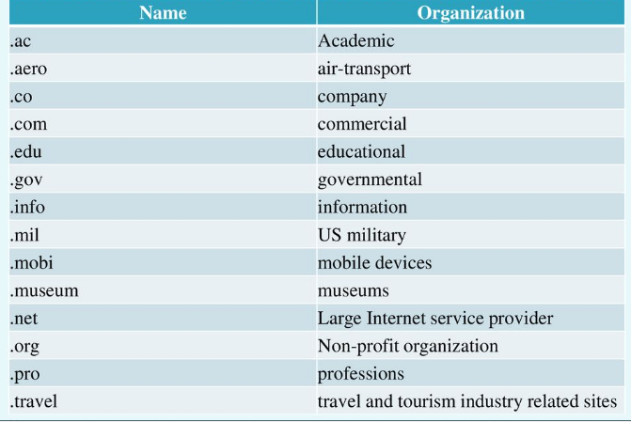
Organization code

Slide 7
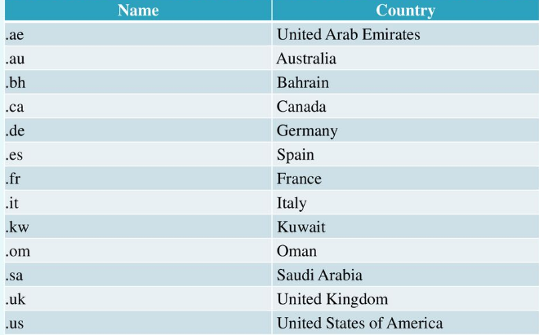
Country code

Slide 8
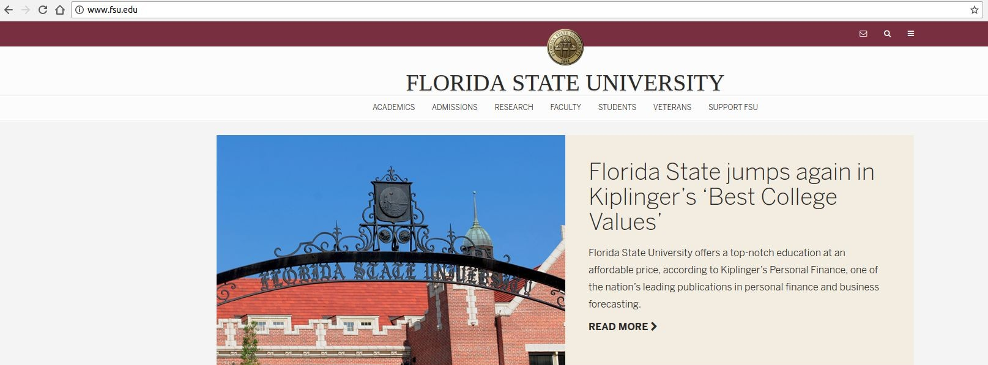
How Does the Web Work
1. You type an address(URL) in a browser address bar

Slide 9


How Does the Web Work
2. Your computer(client) performs a DNS lookup
Each website has a unique code, called an IP address, like a phone number.
DNS, or Domain Name Servers, are like phone books.
The DNS servers will connect you to the right server.
www.fsu.edu
DNS
Server
146.201.111.62

Slide 10
How Does the Web Work
3. Your computer uses the IP address to find the web server and requests a page.
Request Protocol
Folder
http://w
ww.fsu.edu/s
tudents/i
ndex.html
Domain Name of Web Server
File Name

Slide 11
How Does the Web Work
4. The server processes your request and responds:
The requested document is unavailable
Redirect the client to another web page
Respond with content from a file
Run a program that decides what content to respond with
The response typically includes some HTML and CSS with some Javascript and potentially some media files.

Slide 12
How Does the Web Work
5. Your browser displays the page by interpreting the response code and assembling different files. Each browser may do this slightly differently.

Slide 13
Domain name system(DNS)
It is hard for us to remember IP Address i.e. 209:85:148:108 but it is easier for us to remember Domain name such as google.com
DNS helps in this! You don’t have to memorize all IP Addresses of your favorite websites!
DNS links a unique IP Address with the domain name you remember and type into a web browser.
Example:
DNS Server links google.com to the IP Address 209:85:148:108

Slide 14
Website
A Website is a collection of various pages written in HTML with an address e.g http://www.google.com.pk.
Each page available on the Website is called a web page and first page of any web site is called home page/landing page for that site.

Slide 15
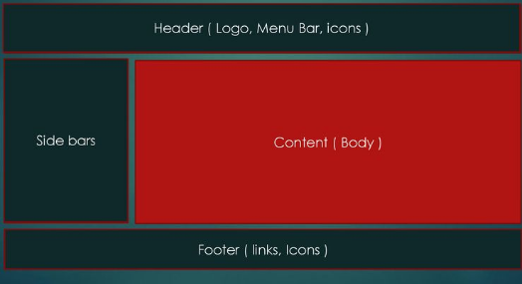
Website structure

Slide 16
Types of websites
Static
Dynamic
Front end
Back end

Slide 17
Static website
Static website is the basic type of website that is easy to create.
You don't need the knowledge of web programming and database design to create a static website.
Its web pages are coded in HTML

Slide 18
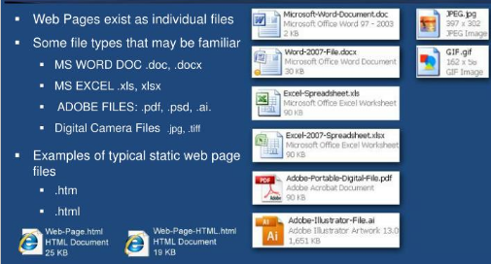
Static websites-pages

Slide 19
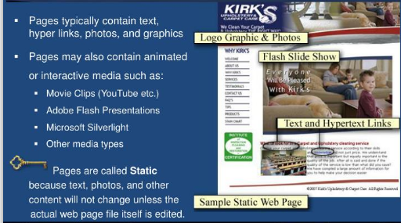
Static website pages

Slide 20
Dynamic website
Dynamic website is a collection of dynamic web pages whose content changes dynamically.
Therefore, when you alter or update the content of the database, the content of the website is also altered or updated..

Slide 21
Dynamic website
Dynamic website uses client-side scripting or server-side scripting, or both to generate dynamic content.

Slide 22
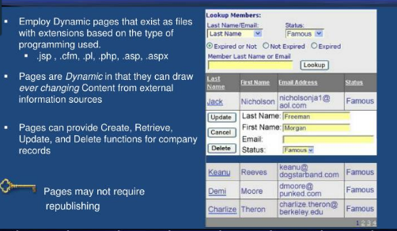
Dynamic websites

Slide 23
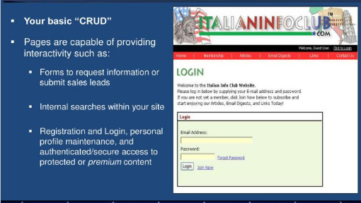
Dynamic website features

Slide 24
Static vs dynamic website
Prebuilt content is same every time the page is loaded. | Content is generated quickly and changes regularly.
It uses the HTML code for developing a website. | It uses the server side languages such as PHP, JSP, and ASP.NET etc. for developing a website.
It sends exactly the same response for every request. | It may generate different HTML for each of the request.
The content is only changed when someone publishes and updates the file (sends it to the web server). | The page contains "server-side" code which allows the server to generate the unique content when the page is loaded.
Flexibility is the main advantage of static website. | Content Management System (CMS) is the main advantage of dynamic website.

Slide 25
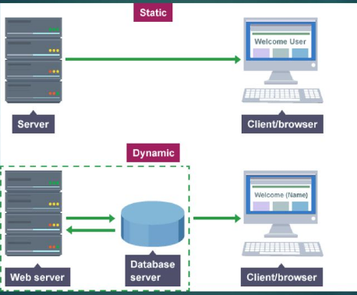
Static vs dynamic

Slide 26
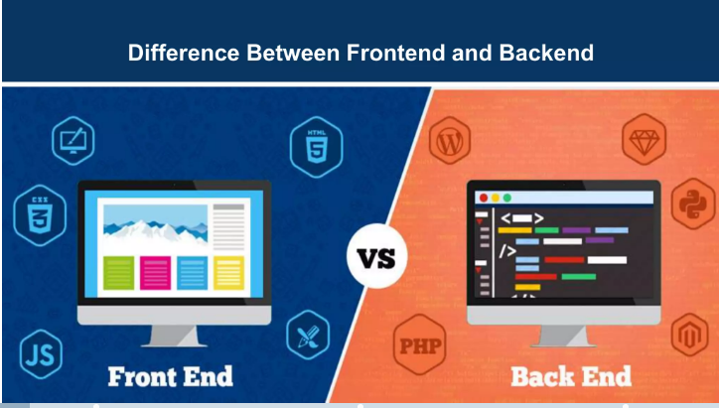

Slide 27
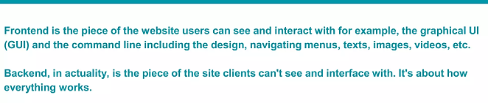
Front end and backend

Slide 28
Essentials of front end vs backend
Front end is referred as client side. Whereas back end is referred as server side of application.
Back end web development includes languages such as java,python,php and back end includes languages such as html CSS and JavaScript

Slide 29
Static is better or dynamic for your websites

Slide 30
Is static right for your organization
Static websites are better choice when you are
Limited in budget and are dealing with 20 pages or less
are planning to add new pages occasionally
need portable and physical web page files

Slide 31
Is dynamic right for your organization
Dynamic websites are better choice when you are
When you need custom programming to accommodate your business needs
need to add or edit web pages( content) within browser
need web pages that display and update records from your information systems

Slide 32
Web hosting

Slide 33
Web hosting
Web hosting is a service that allows organizations and individuals to post a website or web page onto the Internet.
A web host, or web hosting service provider, is a business that provides the technologies and services needed for the website or webpage to be viewed in the Internet.
Websites are hosted, or stored, on special computers called servers.

Slide 34
Web hosting
A company who will either:
Rent you space on one of their web servers
Rent you an entire server
Rent you space on a shared server that you can use like a dedicated server
Connect your own server to their Internet Connection

Slide 35
Hosting Platforms
Windows Hosting Servers : If you have Windows then you will find many hosting servers for Windows and you can buy space from these servers.
Normally Windows hosting server are more expensive because of lot of software licensing costs are involved with these servers.
Linux Hosting Servers: If you want to go for Linux then opportunities are unlimited and you will have to pay less then what you will pay for Windows Hosting Server.
There are many ISPs who provide Hosting Servers with different flavors of Unix.

Slide 36
Web host service providers
Some specific types of hosting provided by web host service providers
File hosting service
Image hosting service
Video hosting service
Blog hosting service
Shop cart software
Email hosting software

Slide 37
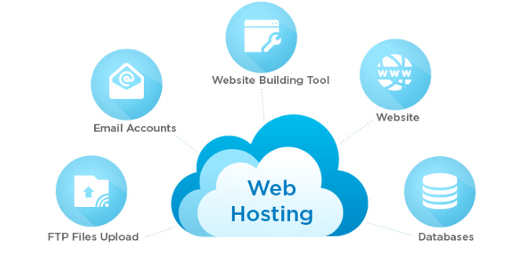
Features of hosting providers

Slide 38
What type of web Hosting Package?
You can get FREE web hosting.
Or you can PAY: The average small business pays £10 - £50 a month, depending on features, web space, and data transfer “bandwidth” required.

Slide 39
Hosting Components
When you buy a Web server space then you should do price comparison between different service providers based on the following components:

Slide 40
1.Having backups for your site
Backups are essential for a website. Even with all the security measures in the world, your website will face some kind of crash, failure, virus, or hack that will take your website down, or worse
That’s where a good backup policy comes in handy because you can always revert back to a working website

Slide 41
2.The quality of customer support (live chat or telephone)
There will be times when you’re faced with a server issue that you just can’t solve by yourself. This where a good customer support team will be essential.
Ideally, you would want to settle with a hosting provider that gives you good and responsive support either via live chat or telephone. That way, you can immediately resolve your website issues.

Slide 42
3.Disc Space
A small or medium web site will need between 10 and 100MB of disk space.
If you plan to keep lot of audio and Video on your web site then you need plan to buy more space.
Before buying server space you should check the options available to expand your disc space if you need it in future.

Slide 43
4.Speeds
Processing Speed: If you are buying space on a shared machine then you can not guess how much speed will be given to you.
In that case only way is to see other hosted sites with the same service provider to know about their hosting quality.

Slide 44
5.Speeds
Connection Speed: Now a days very fast connection speed is available from most of the service providers.
So choose a service provider who is giving better connection speed in terms of bits per second.
You can have connection speed ranging from 64Kb per second to 2.488Gb per second or more??

